Slide 1
Super HBVD Bros.
CYBR-8456 Semester Project Spring 2021
Henry McNeil, Casey Schmitz

Slide 2
Project Goals
Learn about the Nintendo Entertainment System’s processor and architecture
Gain an understanding of 6502 assembly
Experiment with debugging tools in popular emulators
Make a ROM Hack of Super Mario Bros. with some simple modifications

Slide 3
The Nintendo Entertainment System
Released in 1983 in Japan as the Famicom
CPU: MOS Technology 6502
Used in Apple 2, Atari 2600, and Futurama’s Bender
5 registers plus status flags
Custom video controller – Picture Processing Unit (PPU)
Cartridges have some combination of ROM, VROM, and battery-powered RAM
ROM banks are 16KB, VROM 8KB
Full SMB game is 40 KB – 2 ROM banks and 1 VROM

Slide 4
History of ROM Hacks
Became popular in the mid-1990s due to emulation
“ROM Hacking” involves dumping a game’s data and modifying it
iNES format is commonly used for NES games
16-byte header followed by raw ROM data
Thousands of ROM Hacks exist for NES, SNES, and many other systems
Everything from simple sprite changes to full reworks

Slide 5
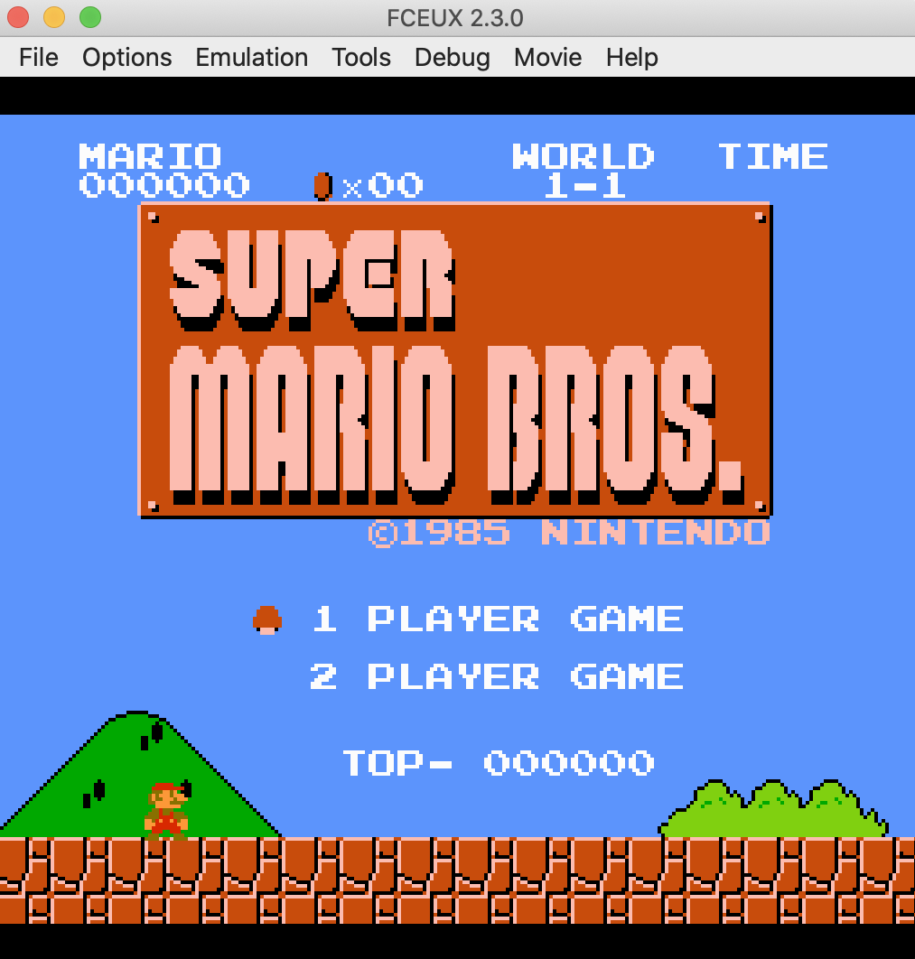
Tools Used
IDA Pro w/ MOS Technologies 6502 Plugin
FCEUX Emulator
Tile Layer Pro
Hex Editors
Caffeine
Patience

Slide 6

Graphics Editing
NES graphics are defined in 8x8 tiles
3 colors plus transparent background
Two bits per pixel, 16 bytes per tile
256 tiles each for sprites and background per 8KB VROM
Tile Layer Pro allows for easy sprite editing
Other game-specific tools exist to edit levels and text

Slide 7
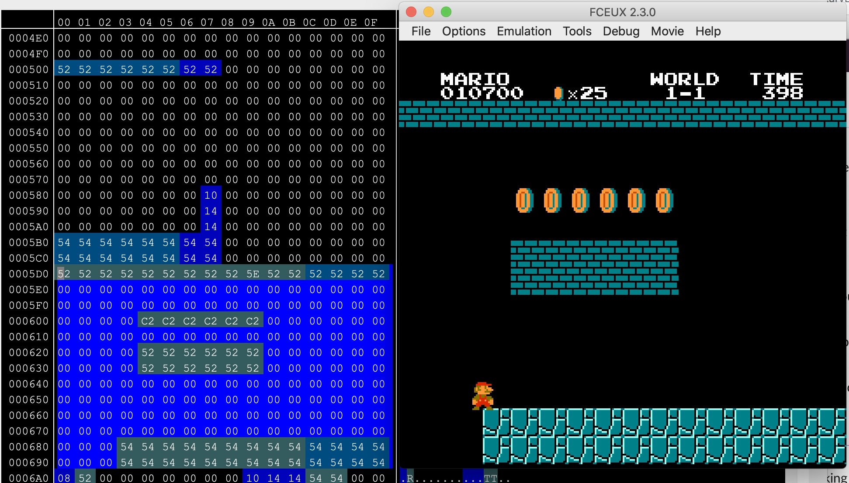
FCEUX Emulator Debugging Tools
FCEUX contains numerous tools which make ROM hacking easier
Debugger
Hex Editor
PPU and Name Table viewers
Loggers
Debugger allows for breakpoints, stepping, etc.
Hex editor can view ROM, RAM, and PPU in real time!

Slide 8
Game Logic Editing: Infinite Lives
We’re bad at Mario! How can we stop losing lives?
Identify memory address used to store remaining lives
Locate player death subroutine
Modify so that it no longer reduces lives on death
Finally rescue the princess!
4 Bytes changed – 3 NOPs and a BPL → BMI

Slide 9

Game Logic Editing: Walk Through Enemies
We’re still really bad at Mario. Can we ignore the enemies?
Find enemy collision subroutine
Remove player injury/death check
Walk through Goombas with impunity!
…Still die to Koopas. Crap.
Remove more injury/death checks
Tell Bowser to get rekt

Slide 10
Resources
Project Page: https://github.com/Vidmaster/hbv-nes
ROM Hacking Community: https://www.romhacking.net/
6502 Assembly: https://en.wikibooks.org/wiki/6502_Assembly
NES Architecture: https://fms.komkon.org/EMUL8/NES.html
FCEUX Emulator: http://fceux.com/web/home.html

